Slide 1
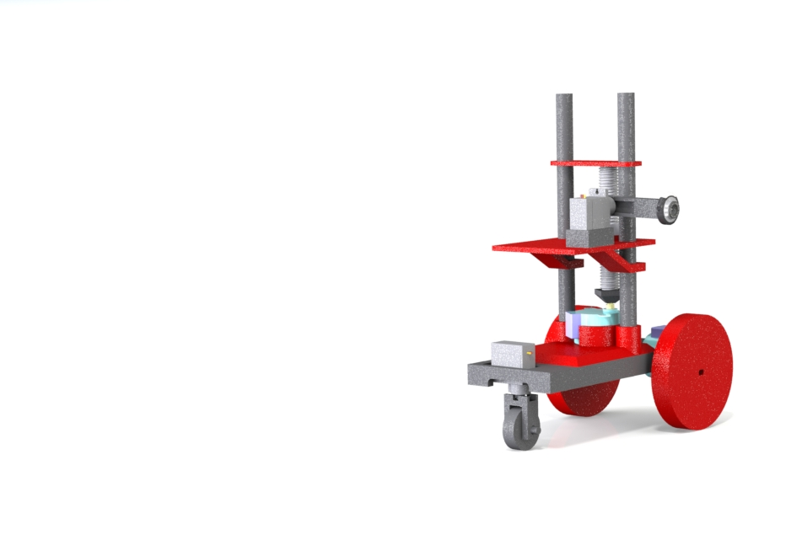
autoGrammetry

Slide 2
Who are we?
We a trio of engineering students from the University of British Columbia. Our interdisciplinary team has a multitude of technical skills including but not limited to mechanical engineering, electrical engineering, programming, and eating.
Manu is a top ranked 3rd year electrical engineering student, proficient in knitting
Friend is a top ranked 4th year mechatronics student, highly interested in indoor lighting
Jonathan is a humble and honest 4th year Integrated Engineering student

Slide 3
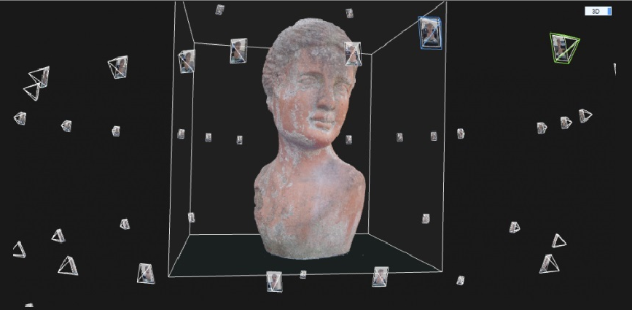
Photogrammetry
Photogrammetry is the process of taking a series of 2D photos from various different angles and using software to stitch them into an accurate 3D model
Many open source solutions exist for stiching the photos together, but the setup for taking the photos is very costly.
Current setups for mid-sized Photogrammetry are costing in excess of $30000 CAD

Slide 4
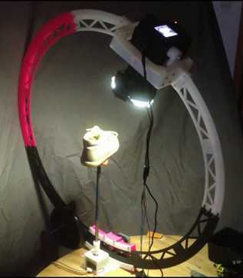
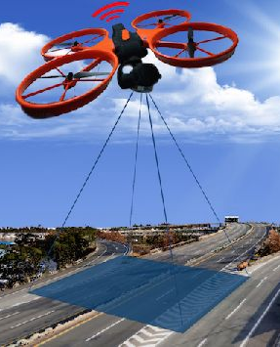
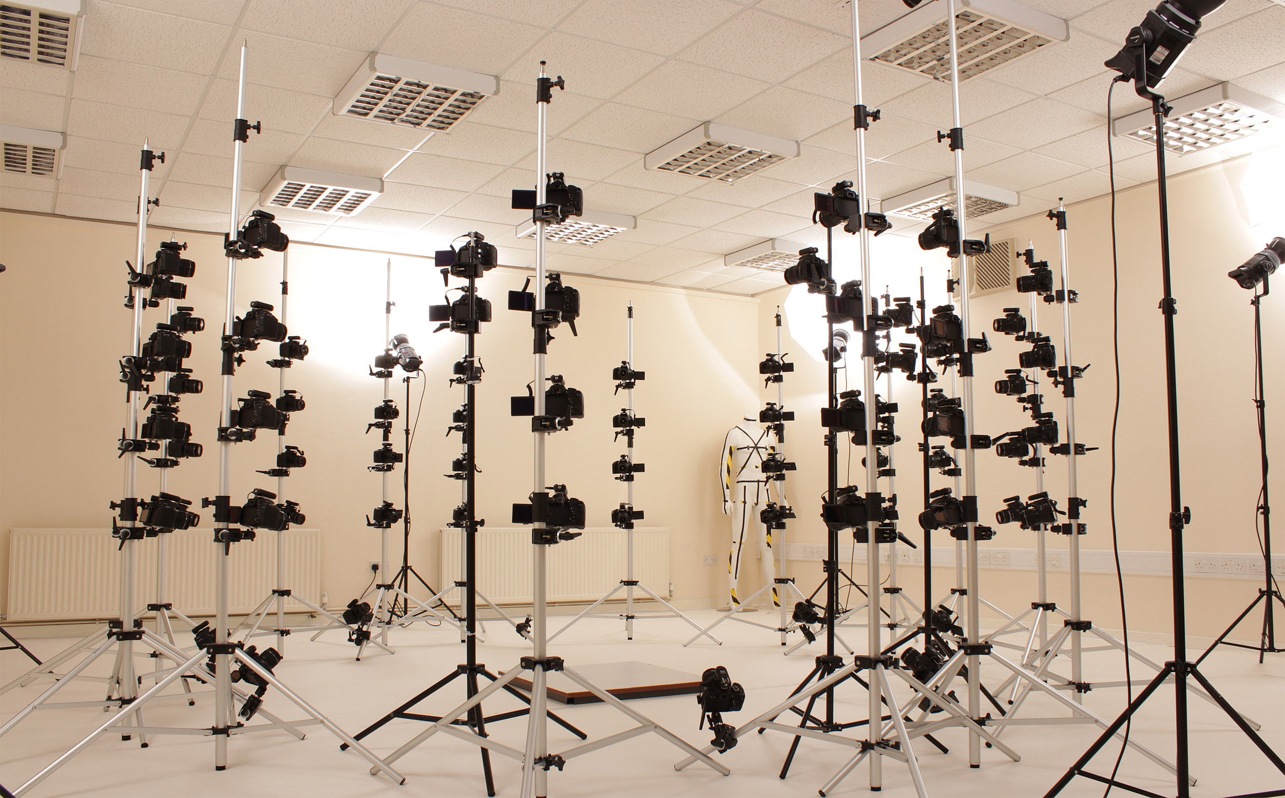
Current Products
Small size:
Many open-sourced automated designs
Mature, saturated designs
Mid size:
Stationary design
Manual setup
No matured design
Large size:
Demanded by researchers
Extremely costly
Mature, saturated designs

Slide 5
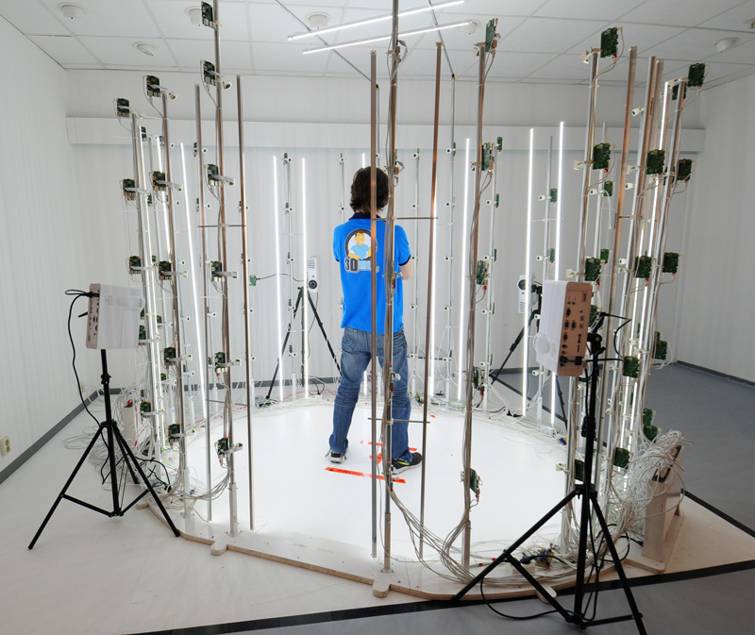
Close Competitor: PI3DSCAN
www.pi3dscan.com
Price: +10k EUR plus assembly labor and software
Issues:
Low quality camera (PiCamera)
Complicated set up
Not easily portable, studio only
Result:
Can not scan outdoor
Lower quality photos
Costly technician labor

Slide 6
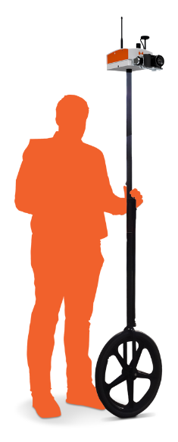
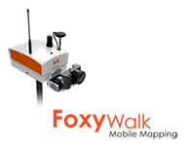
Close Competitor: FoxyWalk
www.heliceo.com/en/produits-pour-geometres/foxywalk-terrestrial-photogrammetry/
Price: need quotes
Issues:
Uses person to handle
No automated movement
No path assignment
No self balancing tool
Result:
Can not go into potentially dangerous areas
Unsteady photos
Costly technician labor

Slide 7
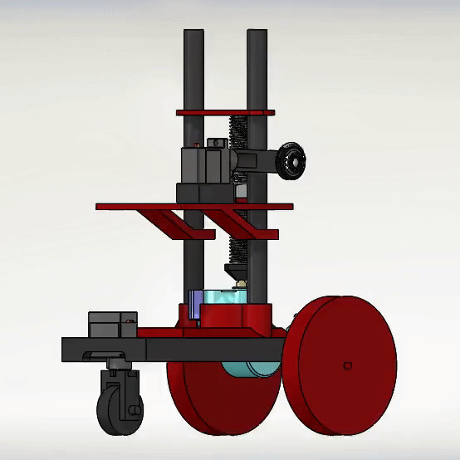
Our Project: autoGrammetry
Using a low-cost unmanned autonomous ground vehicle to automate the process of positioning a camera and taking photos in the required angles for photogrammetry.
The vehicle, with a mounted camera, circles an object at an adequate radius, taking photos at regular intervals/angles, at various different camera heights, creating a high quality set of photos suitable for photogrammetry.
The photos can be sent to a computer or sent to the cloud, for remote scans.
This prototype can be scaled up to scan larger objects, maintaining a low relative cost.

Slide 8
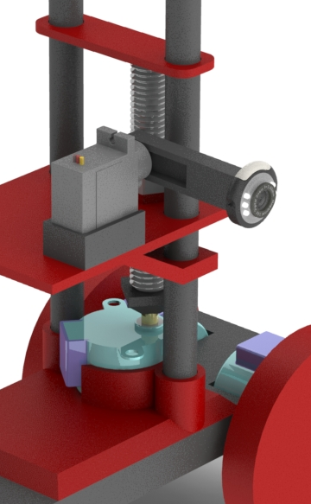
Technical Overview
The vehicle is driven by two stepper motors to create an accurate trajectory for taking photos.
The vertical position of the camera is driven by a linear stage, to enable the creation of the full perspective of the target objects.
A servo motor adjusts the orientation of the camera as needed to get the optimal perspective.
An arduino controls the system’s movement.
The camera is connected to a computer, taking photos, storing them and/or uploading them to the cloud for remote research.
The current model has a vertical camera travel of 100mm, and the camera can adjust itself over 180 degrees.
The prototype was built with components costing less than $50.
Competitively priced, portable, suitable for rougher environments, remote usage, lesser hardware

Slide 9
Future Expansion:
Feedback loop using additional sensors
Automatic path tracking and exporting
Scaling up the prototype for larger scans
Implementing bluetooth and cloud save functionality
Full integration with photogrammetry software
Gyroscope for enhanced uneven terrain stability
Mobile app
GPS and self deployment
4G/5G/LTE connectivity

